Slide 1
Capstone Engagement
Assessment, Analysis, and Hardening of a Vulnerable System

Slide 2
Table of Contents
This document contains the following sections:
01
Network Topology
02
Red Team: Security Assessment
03
Blue Team: Log Analysis and Attack Characterization
Hardening: Proposed Alarms and Mitigation Strategies
04

Slide 3
Network Topology
‹#›

Slide 4
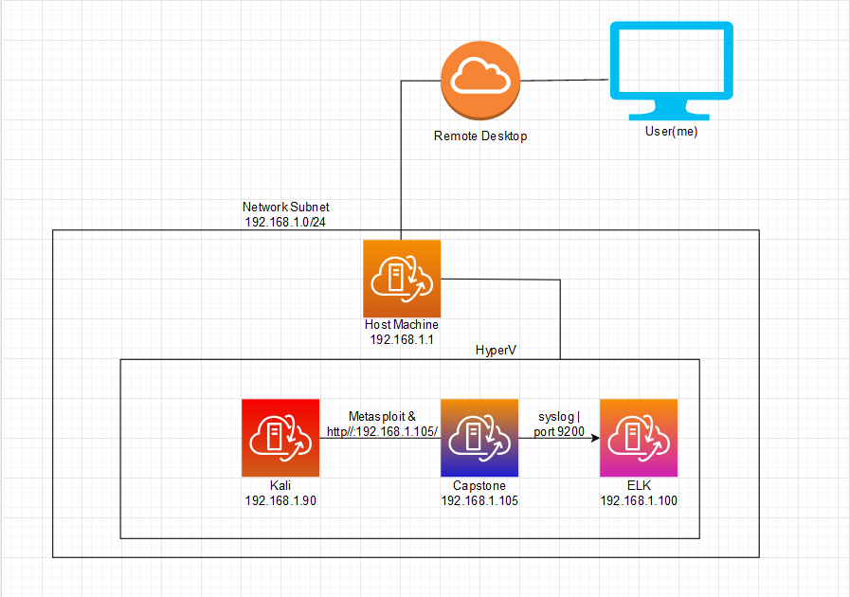
Network Topology
[Insert Here]
Network
Address Range:
192.168.1.0/24
Netmask: 255.255.225.0
Gateway: 192.168.1.1
Machines
IPv4: 192.168.1.90
OS: Kali
Hostname: Kali
IPv4: 192.168.1.100
OS: Ubuntu
Hostname: ELK
IPv4: 192.168.1.105
OS: Ubuntu
Hostname: Capstone
IPv4: 192.168.1.1
OS: Microsoft Windows
Hostname: ML-RefVm-684427 (Host)

Slide 5

Red Team
Security Assessment
‹#›

Slide 6
Recon: Describing the Target
Nmap identified the following hosts on the network:
Hostname | IP Address | Role on Network
 | 192.168.1.1 | This is the host of the three other virtual machines on the network including the attacking machine.
Kali | 192.168.1.90 | This machine is the attacking machine and was used to infiltrate and exploit the Capstone machine.
ELK | 192.168.1.100 | ELKstack was hosted on this machine and stored the metrics and logs from the Capstone machine. It recorded the attack logs.
Capstone | 192.168.1.105 | This is the victim machine. It hosted the webserver that Kali found and exploited. Eventually files were upload to this machine and a reverse shell was created.

Slide 7
Vulnerability Assessment
The assessment uncovered the following critical vulnerabilities in the target:
Vulnerability | Description | Impact
Use the CVE number if it exists. Otherwise, use the common name. | Describe the vulnerability. | Describe what this vulnerability allows the attacker to do.
Sensitive Data Exposure CWE-200 | Sensitive information is exposed to an actor that is not explicitly authorized access the information. | SDE allows an actor to view and private information including company secrets or login information.
Brute Force Vulnerability CWE-307 | The software does not implement security measures to prevent multiple failed logins within a short period of time. | An actor can use software, such as Hydra, to continually attempts logins within a short period of time until the correct login is found.
Unauthorized File Upload CWE-434 | The software allows an actor to upload or transfer files of dangerous types. | An actor can upload malware or malicious code to utilize in gaining access to the system. e.g. php files.
Notes:
(I’m using CWE because I don’t think these vulnerabilities are directly because of a software or server, but improper setup and securing software and web servers)
CWE-200 source: https://cwe.mitre.org/data/definitions/200.html CWE-307 source: https://cwe.mitre.org/data/definitions/307.html
CWE-434 source: https://cwe.mitre.org/data/definitions/434.html

Slide 8
Exploitation: Sensitive Data Exposure | CWE-200
01
02
Tools & Processes
Utilized Nmap to gain information the network.
Used DIRB to scan the IP as a url and find the files on the web server (this exposed information about WebDAV.
Visited the site http://192.168.1.105 and was able to look through the publicly available files.
Achievements
Nmap exposed the web server
Using DIRB I was able able to see that the there were files related to WebDAV, giving a hint to what kind of internal server is being used on the network between the computers
After visiting the site I found information about a secret folder and that Ashton had the read and write rights for it.

Slide 9
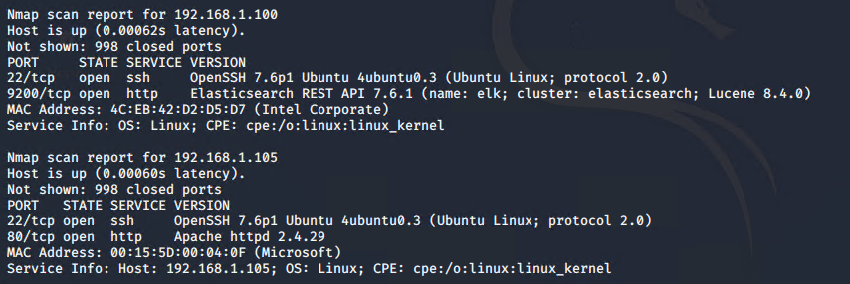
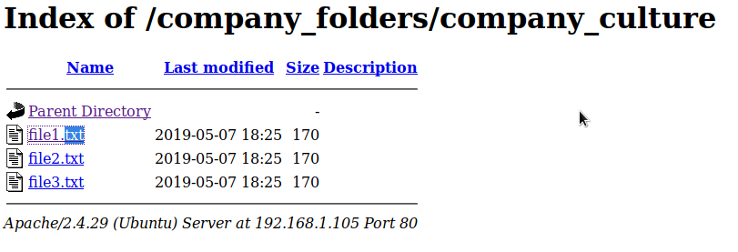
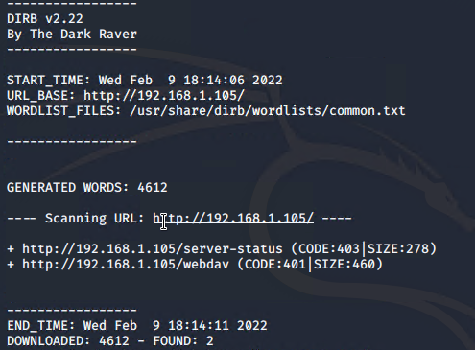
Exploitation: Sensitive Data Exposure | CWE-200 (Visuals)
03
Nmap scan of the network.
Websites public files, within these files I found information about Ashton’s job duties and the secret folder.
DIRB scan of the web server

Slide 10
Exploitation: Brute Force Vulnerability | CWE-307
01
02
Tools & Processes
Using the information gathered by looking through the webserver exposed files. I was able to navigate to http://192.168.1.105/company_folders/secret_folder this gave a login pop up.
Now knowing the url to attack I used Hydra to attack the url with a txt file that has the most common password, this txt file was from rockyou password leak.
Achievements
I was able to brute force the password glean Ashton’s password.
From there I was able to login and look through the secret_folder that was mentioned in the public files.
Within the secret_folder was a personal not that gave me instructions on access the WebDAV.
This file also held information about Ryan being the account used to access the WebDAV and provided ryan’s hash I cracked using crackstation. I now had Ryan’s password.

Slide 11
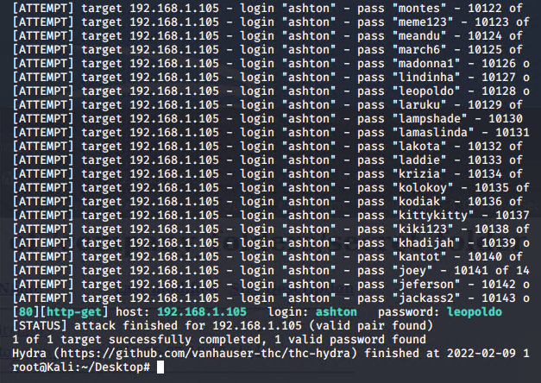
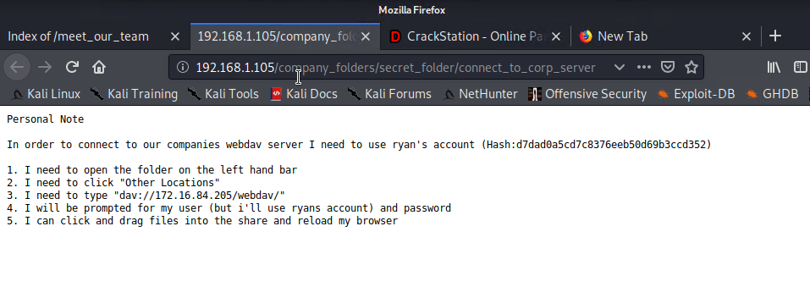
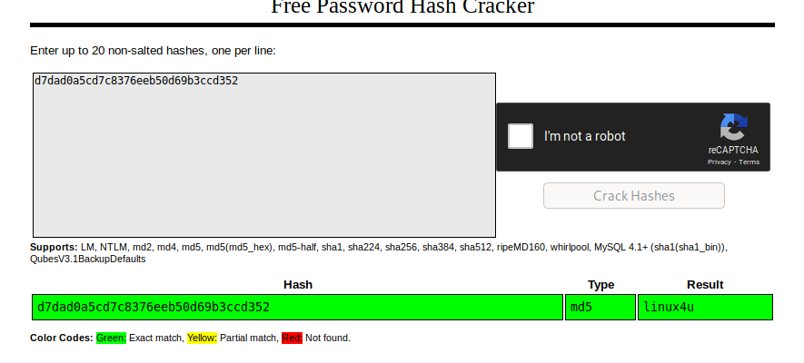
Exploitation: Brute Force Vulnerability | CWE-307 (Visuals)
03
Contents of the personal note file
Results from the Hydra attack.
Results from cracking Ryan’s password hash

Slide 12
Exploitation: Unauthorized File Upload | CWE-434
01
02
Tools & Processes
Using the instruction found in the Personal Note I access the WebDAV server.
I went to files and typed in dav://192.168.1.105/WebDAV/ into the file header and was met with a login screen.
I used Ryan’s login credentials to gain access and look through the files.
Now knowing I can upload files to the Capstone computer I used msvenom to develop a php file name hello_world.php
I then uploaded the php file to the WebDAV server.
Achievements
After uploading the file I was able to run the php file and then use metasploit to create a meterpreter on the Capstone computer.
I now was able to navigate the files of the Capstone with all the permissions that Ryan had since his account uploaded the php file.
Navigating the files I quickly located the flag.txt file and able to read it.

Slide 13
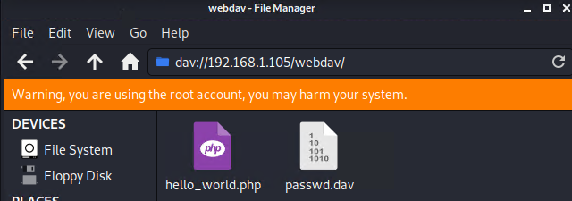
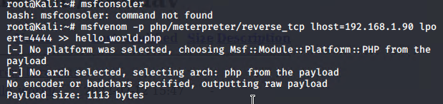
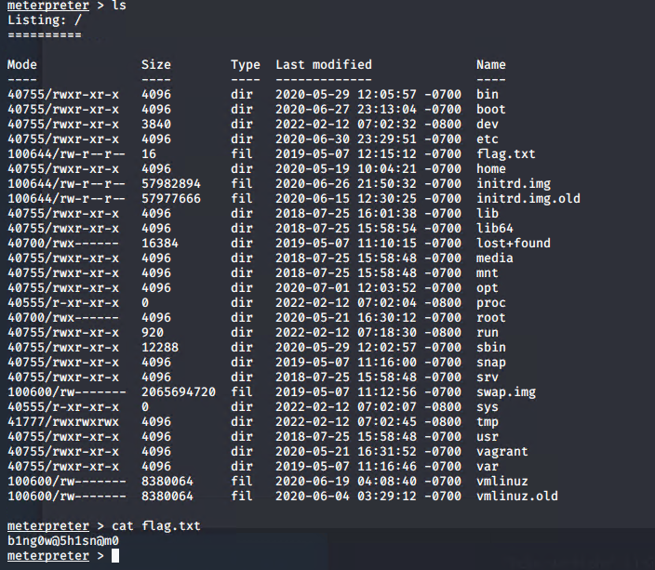
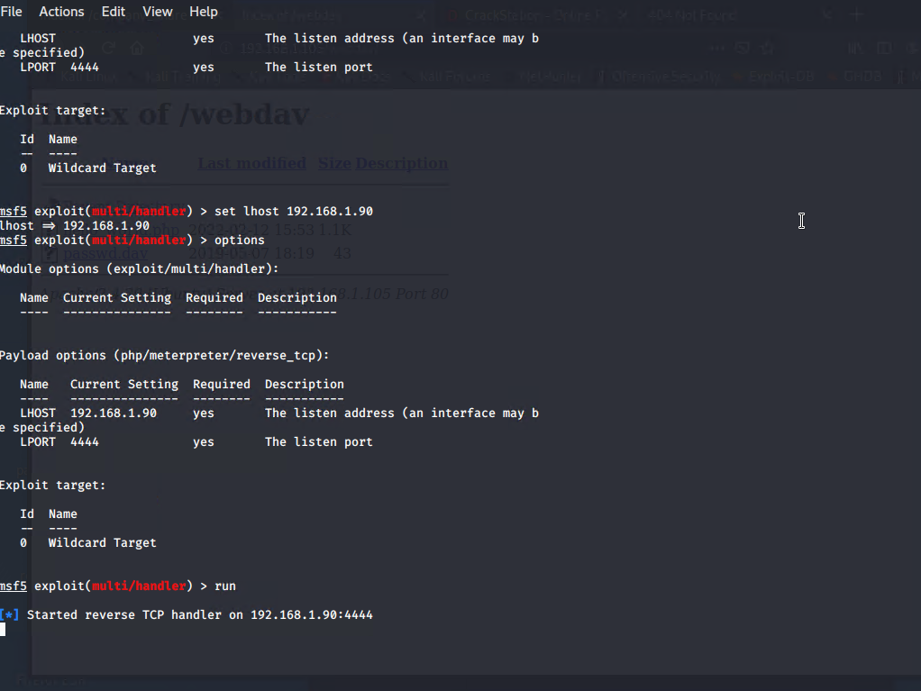
Exploitation: Unauthorized File Upload | CWE-434 (Visuals)
03
Creating the php script with msvenom
WebDAV contents after uploading the php file.
Flag located and read.
Using metasploit

Slide 14

Blue Team
Log Analysis and Attack Characterization
‹#›

Slide 15

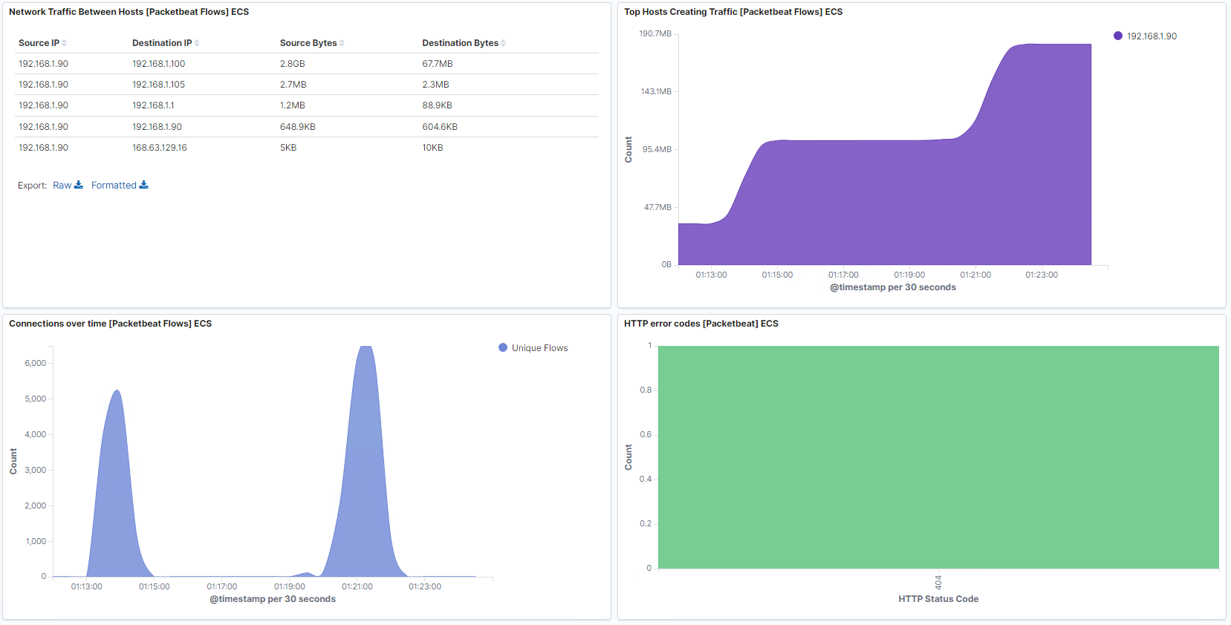
Analysis: Identifying the Port Scan
Answer the following questions in bullet points under the screenshot if space allows. Otherwise, add the answers to speaker notes.
What time did the port scan occur?
How many packets were sent?
What indicates that this was a port scan?
[Insert Here]
Include a screenshot of Kibana logs depicting the port scan.
Notes:
The port scan occurred between 1:12am and 1:25am.
11,252 packets were sent
The biggest indicator of the network scan is the network traffic between hosts reveals that the same source IP is connecting to multiple destination IP’s in the span of a few minutes.

Slide 16
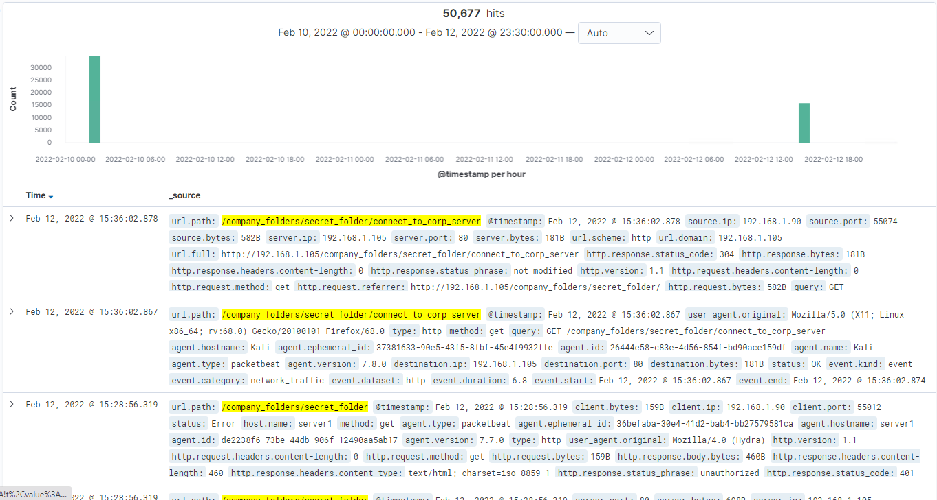
Analysis: Finding the Request for the Hidden Directory
Answer the following questions in bullet points under the screenshot if space allows. Otherwise, add the answers to speaker notes.
What time did the request occur? How many requests were made?
Which files were requested? What did they contain?
[Insert Here]
Include a screenshot of Kibana logs depicting the request for the hidden directory.
Notes:
Requests were made at 2:00am on 02/10 and at 3pm 2/12
50,677 in total were made.
the file connect_to_corp_server was requested and was received
this file contains information about access the WebDAV server.

Slide 17
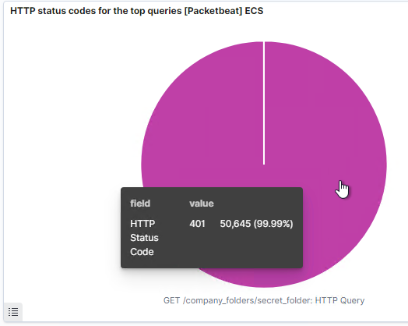
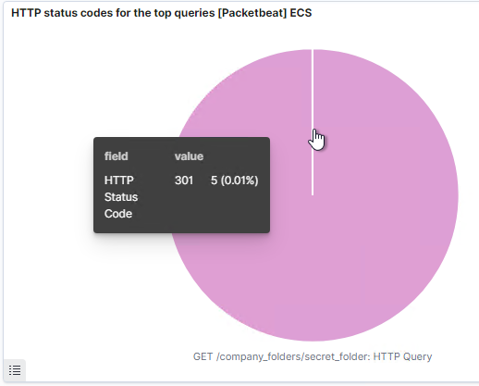
Analysis: Uncovering the Brute Force Attack
Answer the following questions in bullet points under the screenshot if space allows. Otherwise, add the answers to speaker notes.
How many requests were made in the attack?
How many requests had been made before the attacker discovered the password?
Notes:
50,650 requests were made during the attack
50,645 requests were sent before receiving the 301 responses
301 response code may be due to typing /company

Slide 18
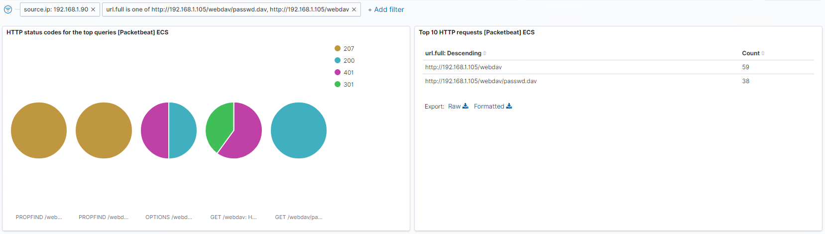
Analysis: Finding the WebDAV Connection
Answer the following questions in bullet points under the screenshot if space allows. Otherwise, add the answers to speaker notes.
How many requests were made to this directory?
Which files were requested?
[Insert Here]
Add a screenshot of Kibana logs depicting the WebDAV connection.
Notes:
97 requests were made to the directory
This included requests to the /WebDAV/passwd.dav directory

Slide 19
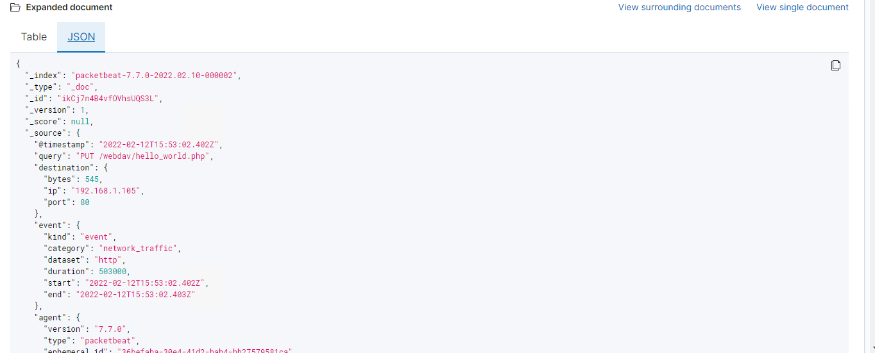
Analysis: Finding the WebDAV Connection
Answer the following questions in bullet points under the screenshot if space allows. Otherwise, add the answers to speaker notes.
How many requests were made to this directory?
Which files were requested?
[Insert Here]
Add a screenshot of Kibana logs depicting the WebDAV connection.
Notes:
file hello_world.php was also PUT into the directory

Slide 20
Blue Team
Proposed Alarms and Mitigation Strategies
‹#›

Slide 21
Mitigation: Blocking the Port Scan
What kind of alarm can be set to detect future port scans?
Look for a single IP reaching out to multiple other IP’s on the network within the span of a minute.
Look for a single IP hitting thousands of ports on other IP’s within the span of minute.
What threshold would you set to activate this alarm?
Set the threshold to 1000 ports touch per second.
What configurations can be set on the host to mitigate port scans?
Install a firewall and only allow specific IP’s to port scan on the network.
Alarms need to set up to trigger if a port scan is detected that isn’t one of the authorized IP’s.
Describe the solution. If possible, provide required command lines.
Using a firewall with alarms in ELK stack should be enough to detect a port scan or block it.
In my opinion blocking a port scan is less important than detecting it and we should prioritize detection.
We can allow specific IP’s by using the following command:
iptables -A INPUT -s <authorized_IP> -j ACCEPT
Allow incoming connection only via a specified port.
iptables -A INPUT -p tcp --dport 80 -i eth0 -j ACCEPT

Slide 22
Mitigation: Finding the Request for the Hidden Directory
What kind of alarm can be set to detect future unauthorized access?
An alarm system needs to be implemented to alert when a user attempts to access the Hidden Directory
What threshold would you set to activate this alarm?
5, should be a good threshold. It’s possible someone may accidentally go to the website, but 5 times is enough to rule out human error.
What configuration can be set on the host to block unwanted access?
The files on the public web server need to be either removed or filtered so that sensitive information is not exposed. Not only was information about file structure and authority provided, but also hints to Ashton’s skill or lack thereof.
Filter authorized IP’s that should be allowed to access the hidden directory.
Configure a firewall to block IP’s that attempt to access the hidden directory.
Describe the solution. If possible, provide required command lines.
I would suggest Ashton’s skills need to be reallocated to a more suitable position to his skill set.
modify the /etc/httpd/conf/httpd.conf file

Slide 23
Mitigation: Preventing Brute Force Attacks
What kind of alarm can be set to detect future brute force attacks?
Multiple failed login attempts on the hidden directory and on the WebDAV
It should also be connected to time, if there is a certain number of failed login attempts with a small period of time.
Logins from the unauthorized IP address
What threshold would you set to activate this alarm?
15 failed login attempts in the span of 30min should set off an alarm and lock the account
What configuration can be set on the host to block brute force attacks?
After 15 failed logins an alarm set off in Kibana and the account should be locked.
2FA should be enabled on account and required.
Cycle passwords every six months
require strong passwords and encourage users to get a password manager, possible pay for one for users.
Limit which IP’s are allowed possibly require them to be on a VPN.
Describe the solution. If possible, provide the required command line(s).
Lies in configure the web server properly. I’m not aware of any commands that can be used to limit attempted logins for either WebDAV or the web server.

Slide 24
Mitigation: Detecting the WebDAV Connection
What kind of alarm can be set to detect future access to this directory?
Have a list of authorized IP’s and set an alarm to go off whenever an attempt to access the WebDAV is made.
If a successful login occurs from an unauthorized IP have an alarm go off.
What threshold would you set to activate this alarm?
5th failed attempts to access the WebDAV server from unauthorized IP
1st success login from unauthorized IP
What configuration can be set on the host to control access?
Have a list of authorized IP’s possibly require a VPN
Increase number of accounts used to access the WebDAV, Ashton should not be using Ryan’s account or even know his password.
Cycle passwords every six months
Describe the solution. If possible, provide the required command line(s).
Add users
sudo htdigest /usr/local/apache/var/users.password WebDAV <username>
when entered it will require adding a password
Cycle passwords
use htdigest.exe

Slide 25
Mitigation: Identifying Reverse Shell Uploads
What kind of alarm can be set to detect future file uploads?
Look for unauthorized IPs that are upload files.
If a php file is uploaded by an unauthorized IP immediately send alert.
Search for unrecognized urls
What threshold would you set to activate this alarm?
If a php file is uploaded or attempted to upload by unauthorized IP send alarm
If there are 10 attempts to upload file from unauthorized IP send alert .
What configuration can be set on the host to block file uploads?
Only allow specific file types and exclude php files.
Filter out authorized IPs
Malware scanner looking for malicious code or malicious software
Store uploaded files into the web root folder or a folder that can’t be normally accessed, this way even if a bad actor uploaded files they wouldn’t be able to access them.
Describe the solution. If possible, provide the required command line.
Filter file extensions like .php
I’m not able to find the commands necessary, but it should be able to done by modifying a config file.

